Slide 1
NEXGO K206
Version 1.2 Issued May 2024
NEXGOGLOBAL.COM
© 2024 NEXGO | The information contained in this document is subject to change without notice. All pictures shown are for
illustration purpose only, actual product and software may vary. NEXGO and the NEXGO logo are either trademarks or registered trademarks of NEXGO in the China and/or other countries. All other trademarks or brand names are the properties of their
respective holders.

Slide 2
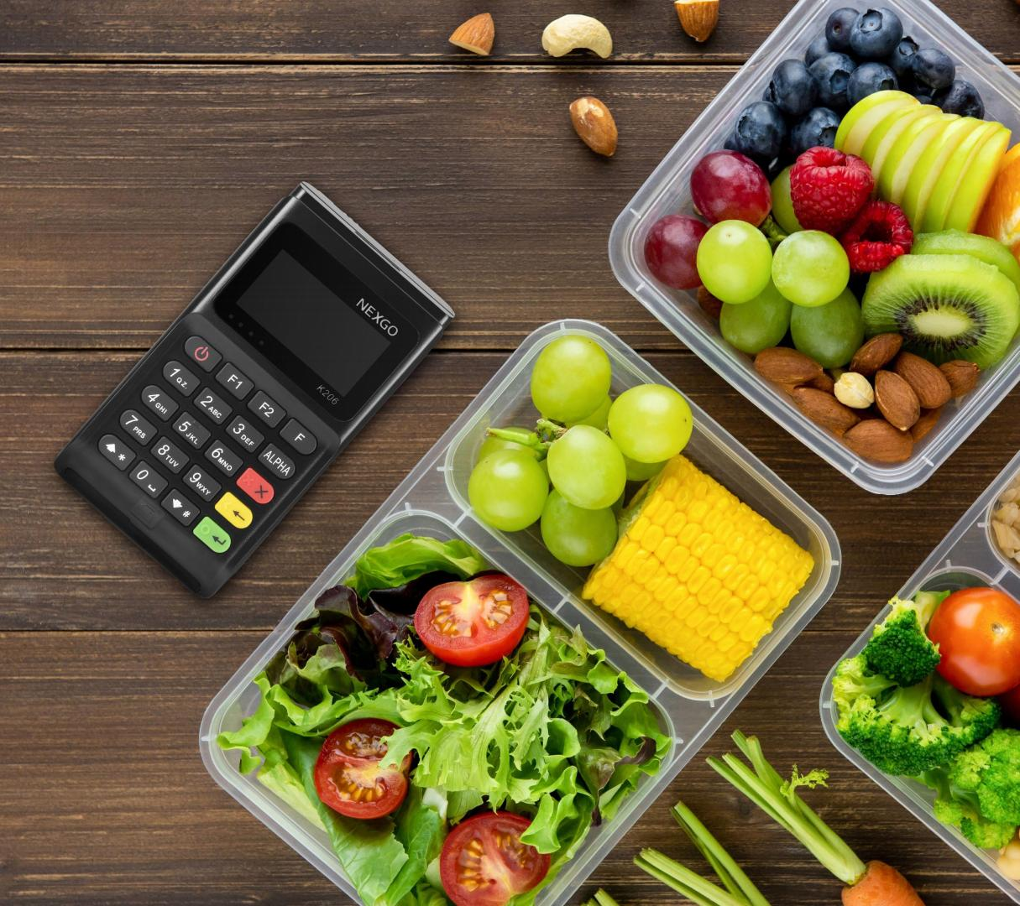
K206
Most Recommended Cost-Effective mPOS

Slide 3
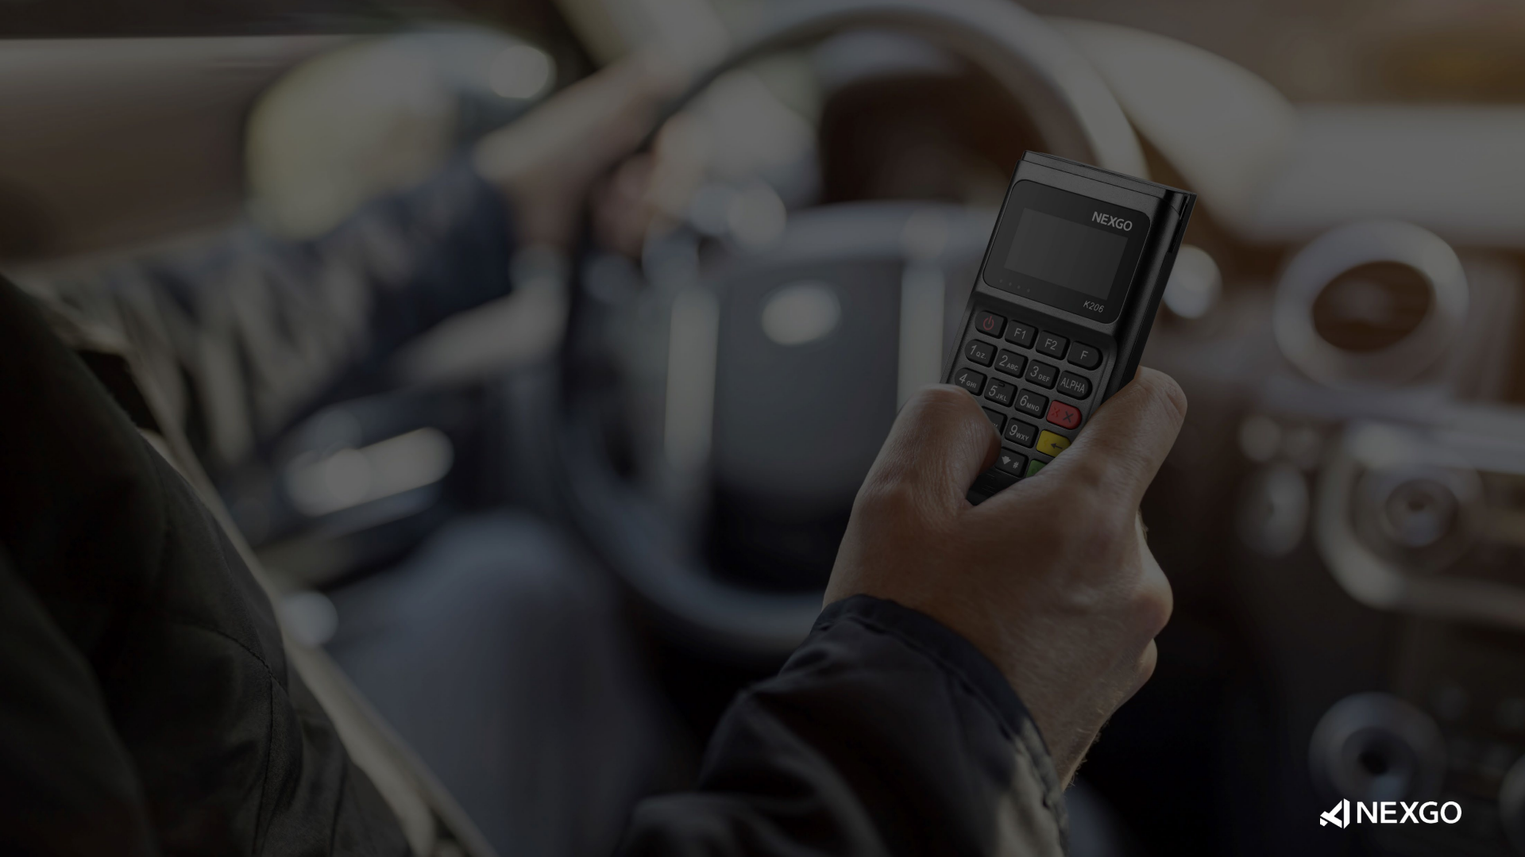
K206 is the most recommended high cost-effective mPOS of NEXGO, it has
passed the latest industry certifications including PCI 6.x. Only weighs 109 g,
K206 is much smaller than your palm, users can take it anywhere.
Cost-Effective
Most Recommended
PCI 6.x
The Latest Secure Standard
mPOS
In Your Pocket

Slide 4
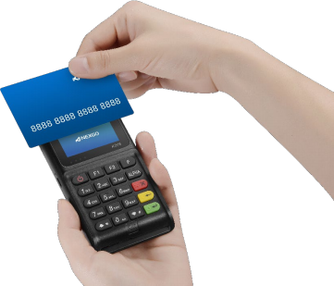
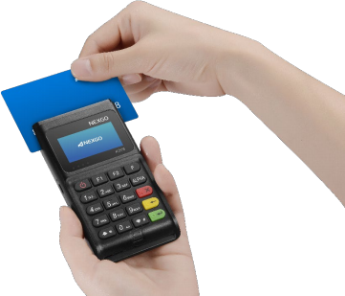
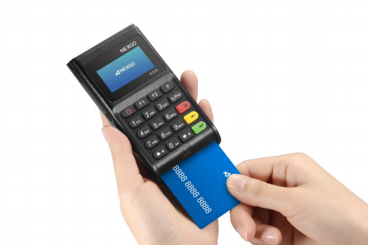
Multifunctional
Through Bluetooth connection to the mobile app, K206 can support the payments of magnetic strip cards, IC cards,
contactless/NFC .
Bluetooth
USB App
contactless/NFC Magnetic Strip Cards IC Cards

Slide 5
PCI 6.x Approved
K206 has passed the certification of PCI 6.x, it represents the latest payment card industry (PCI) security standards.
More Certifications

Slide 6
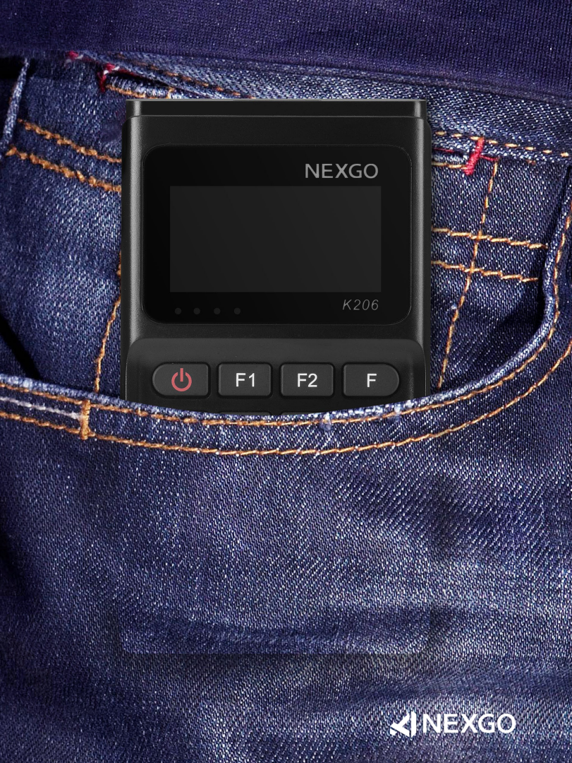
mPOS in Your
Pocket
The compact design of K206 can fully meet the requirements of users for portability with the size of 119 x 65 x 21 mm.
109 g
Weight (Battery Included)

Slide 7
K206 mPOS
OS NEXGO OS | Audio 1 x Buzzer | Adaptor DC 5V/1A | Processor Cortex-M4 120MHz
Card Readers Magnetic stripe cards Chip Cards Contactless Cards | Keys 20 keys for Numbers, Letters, Functions and Power | Physical 119mm L x 65mm W x 21mm H 109g ( Battery Included) | Memory 256KB RAM+4MB ROM
Display (128 x 64) LCD with Backlight | Communication BT5.0 | Ports 1 x Type C | Environmental Operating Temperature : 0°C to 50°C Storage Temperature : -20°C to 70°C
Battery 3.7V/500mAh | PIN Pad Hardware PIN Pad | Certifications CE,NCC,ROHS/WEEE;EMV3.0,L1& L2, Quickpass, Paypass, PayWave, AMEX,Rupay,WPC PCI6.X

Slide 8
THANK YOU!
NEXGOGLOBAL.COM
© 2024 NEXGO

